Slide 1








Slide 2
ABOUT THE TEAM
SUNITHA DEVI KONETI | IBTEDA AZEEM
M.C.A TO LEARN THE UPDATED TECHNOLOGY 2 YEARS OF EXPERIENCE IN MANUAL TESTING MOTIVATION AND SUPPORT IN EVERY ASPECT IN LEARNING PROCESS | B.TECH(Electrical and Electronics) TO LEARN THE UPDATED TECHNOLOGY MOTIVATION AND SUPPORT IN EVERY ASPECT IN LEARNING PROCESS

Slide 3
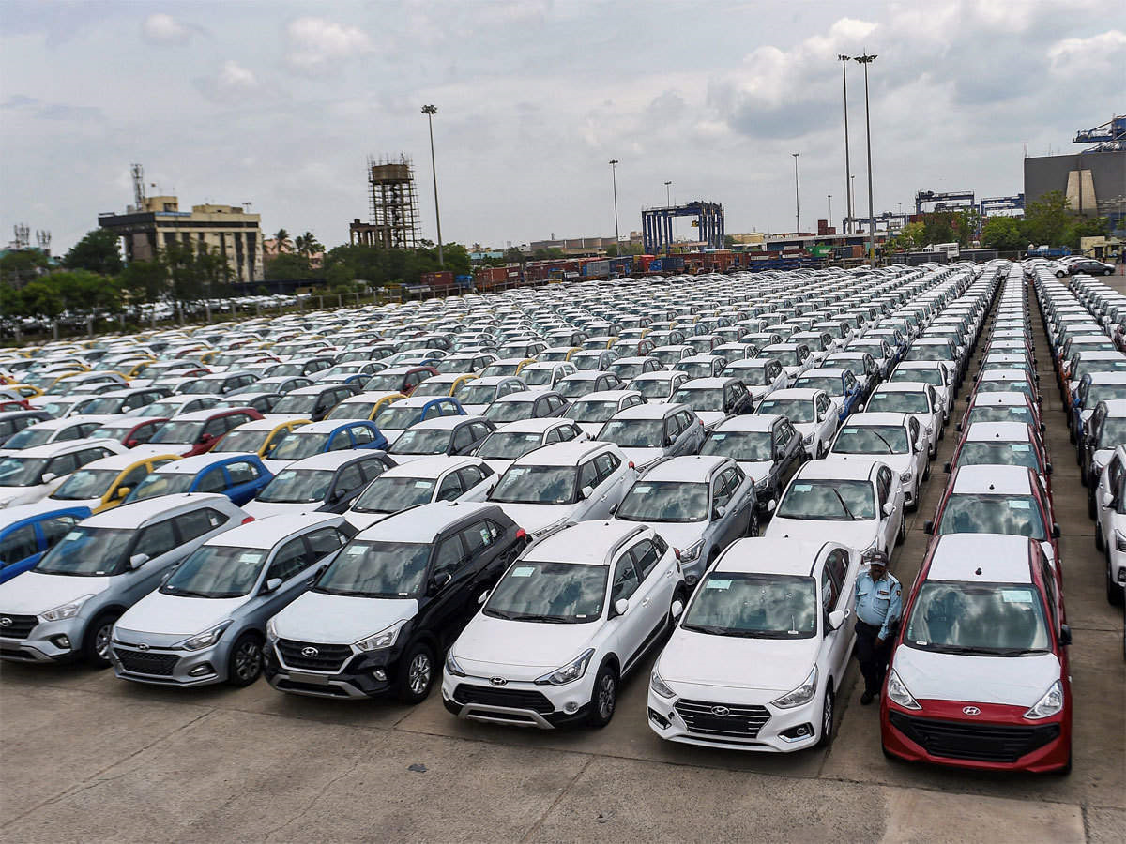
USED CARS DATA ANALYSIS

Slide 4
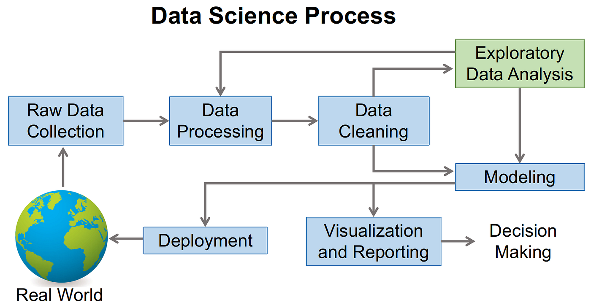
DATA SCIENCE LIFECYCLE
PROBLEM STATEMENT/ BUSINESS UNDERSTANDING DATA COLLECTION DATA CLEANING DATA ANALYSYS DATA VISUALIZATION FEETURE ENGINEERING MODEL BUILDING MODEL EVALUATION MODEL DEPLOYMENT

Slide 5
PROBLEM STATEMENT
How many used cars are of different make and models, of different price ranges are available in different cities and states and how their prices are affected by other features of the car?

Slide 6
LIBRARIES USED
NUMPY
PANDAS
REQUESTS
BEAUTIFULSOUP
RE
MATPLOTLIB.PYPLOT
SEABORN
PLOTLY_EXPRESS
WARNINGS

Slide 7
DATA COLLECTION
STEPS FOLLOWED IN DATA COLLECTION
Requesting the website
Collecting URL from the page
Copying tab name and class type by inspecting feature
Based on the requirement we will take the columns
Converting the data to CSV file
By creating a Dictionary we have converted raw to data frame
We have scraped 2890 rows 13 columns

Slide 8
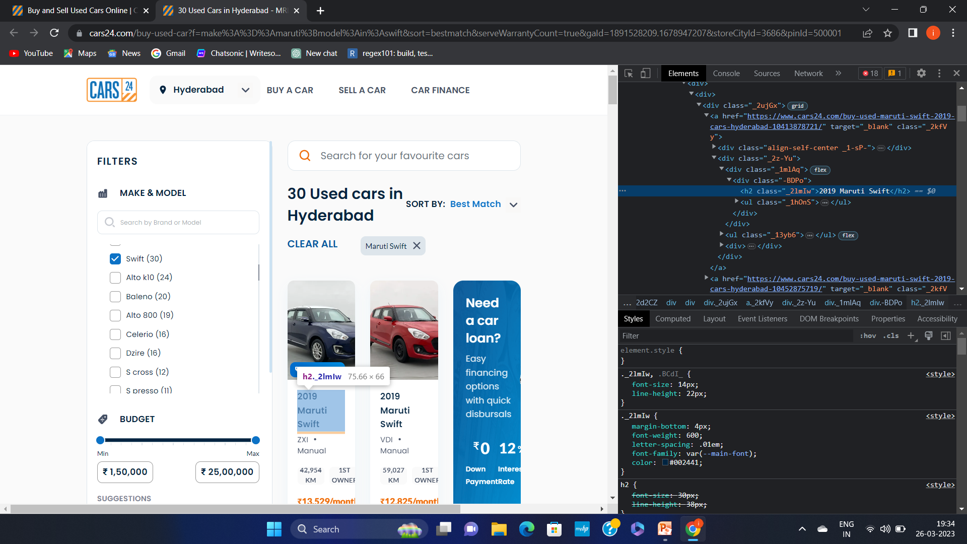
DATA COLLECTION
THE DATA SET IS COLLECTED FROM SCRAPING THE WEBSITE CARS24. THE DATA CONTAINS 13 COLUMNS AND 2890 ROWS. OUT OF 13 COLUMNS 7 ARE CATEGORICAL AND REMAINING 6 ARE NUMERICAL. WE USED PYTHON LIBRARIES AND URL AND HTML SCRIPT OF THE WEBPAGE TO EXTRACT THE DATA

Slide 9
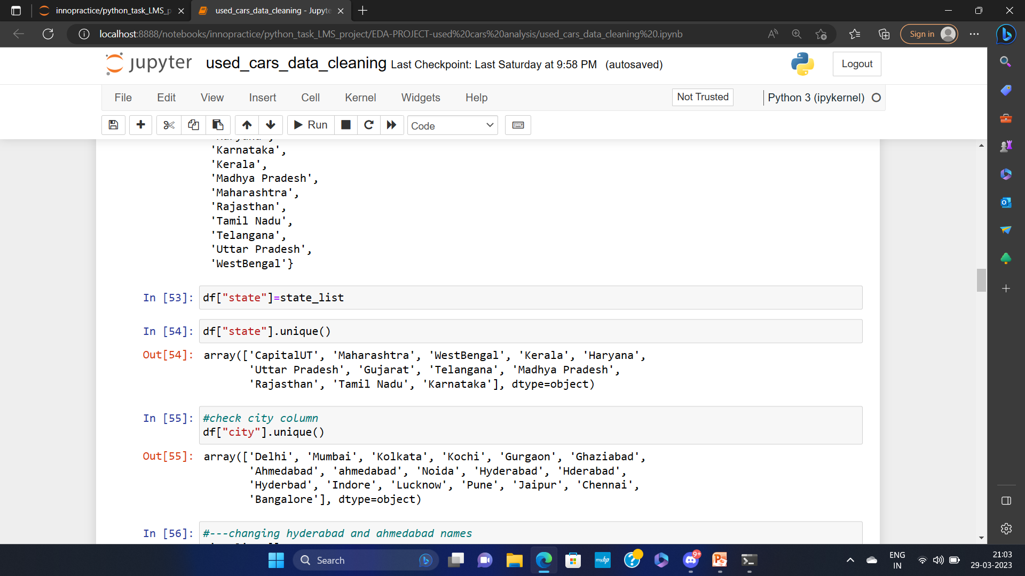
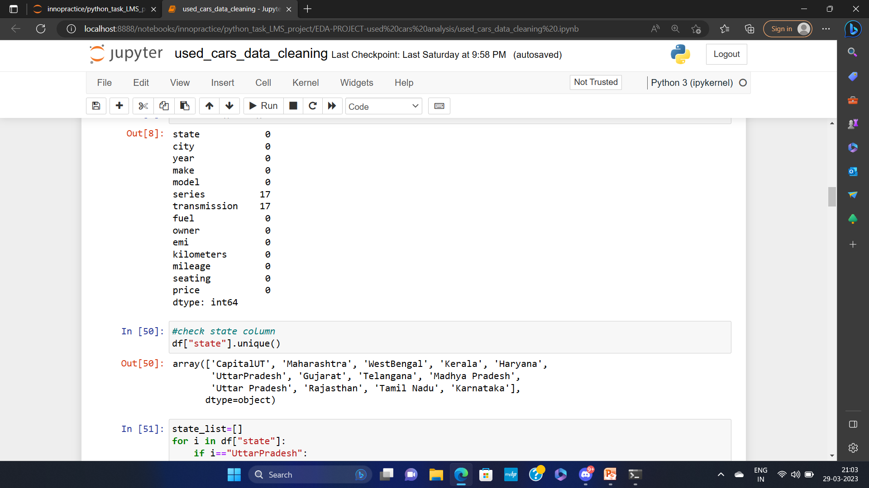
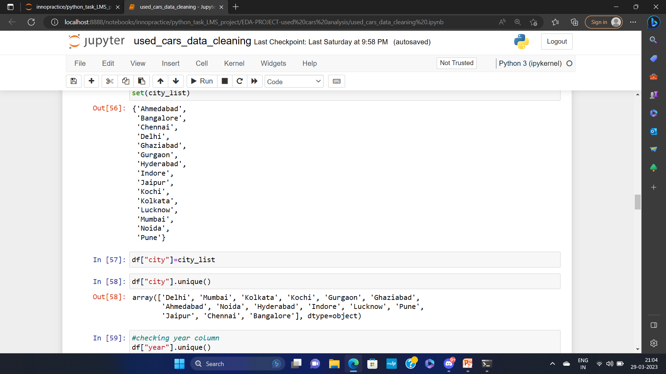
DATA CLEANING PROCESS
Our raw data consists of 2890 rows and 18 columns.
First four columns are unnamed columns which are just duplicated values of index so we removed these columns.
we check unique values in each categorical columns first.
We keep one unique value for each,city,state,make and model
In the transmission column we fill the missing values with "manual" because it is the mode.
year, fuel and owner column need not be changed.
the series column has incoherent values so we drop that column.
Now our data is cleaned with 2890 rows and 13 columns

Slide 10
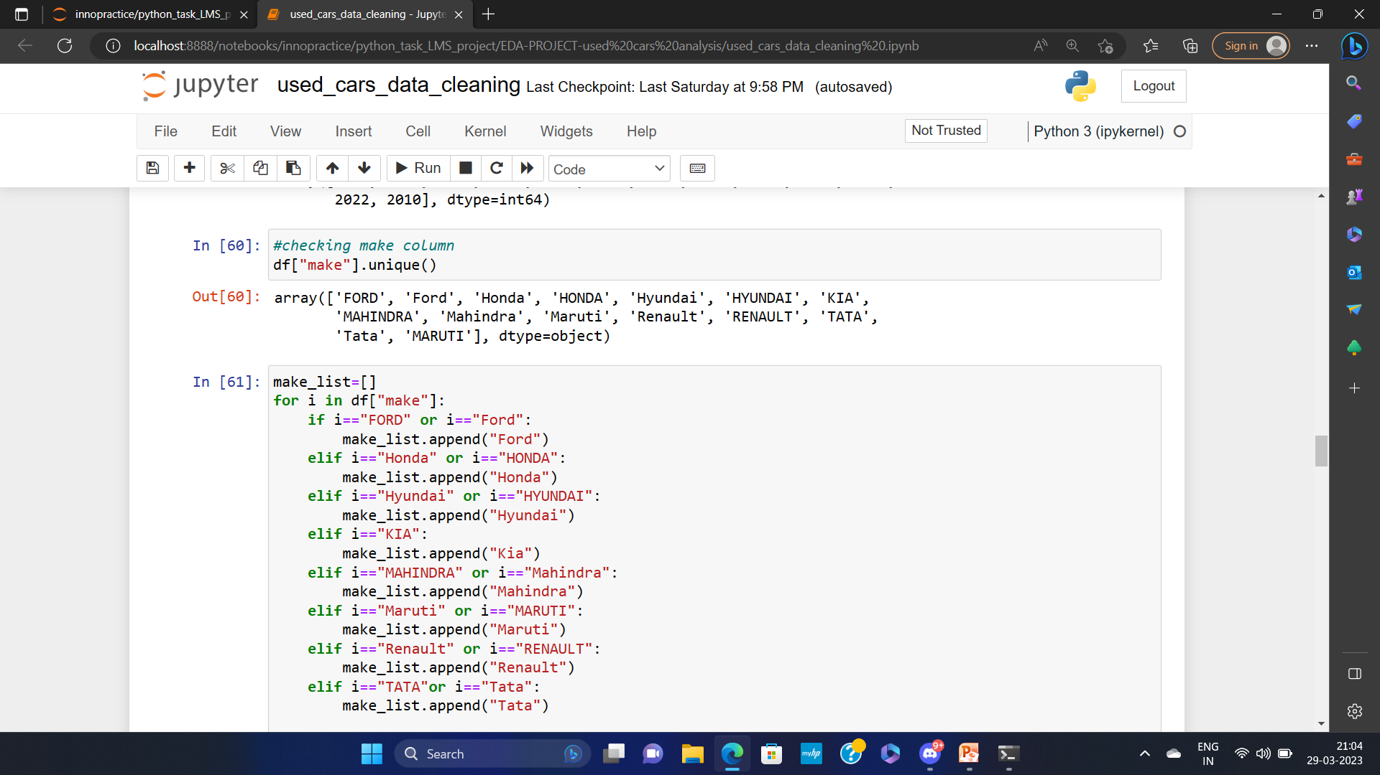
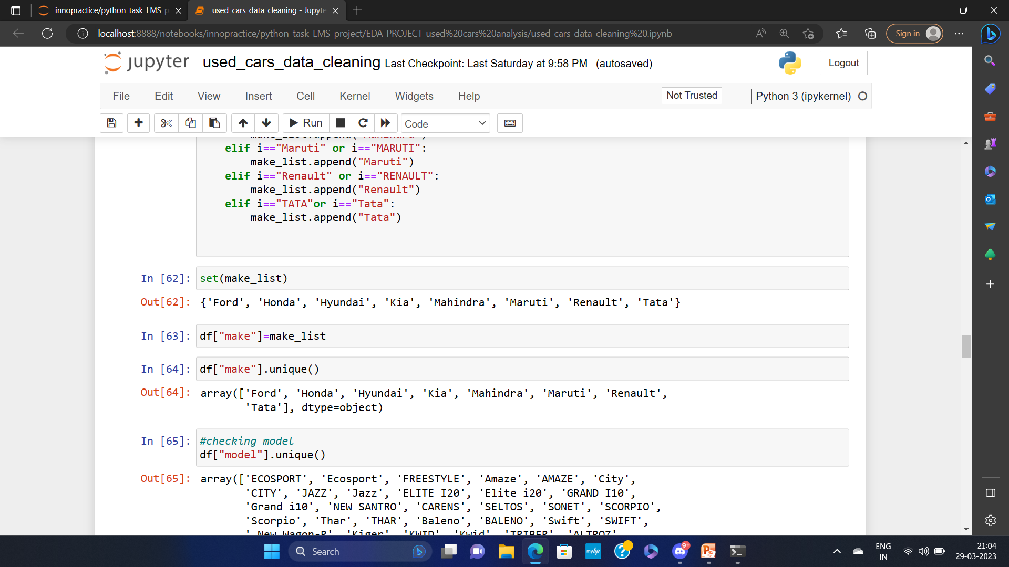
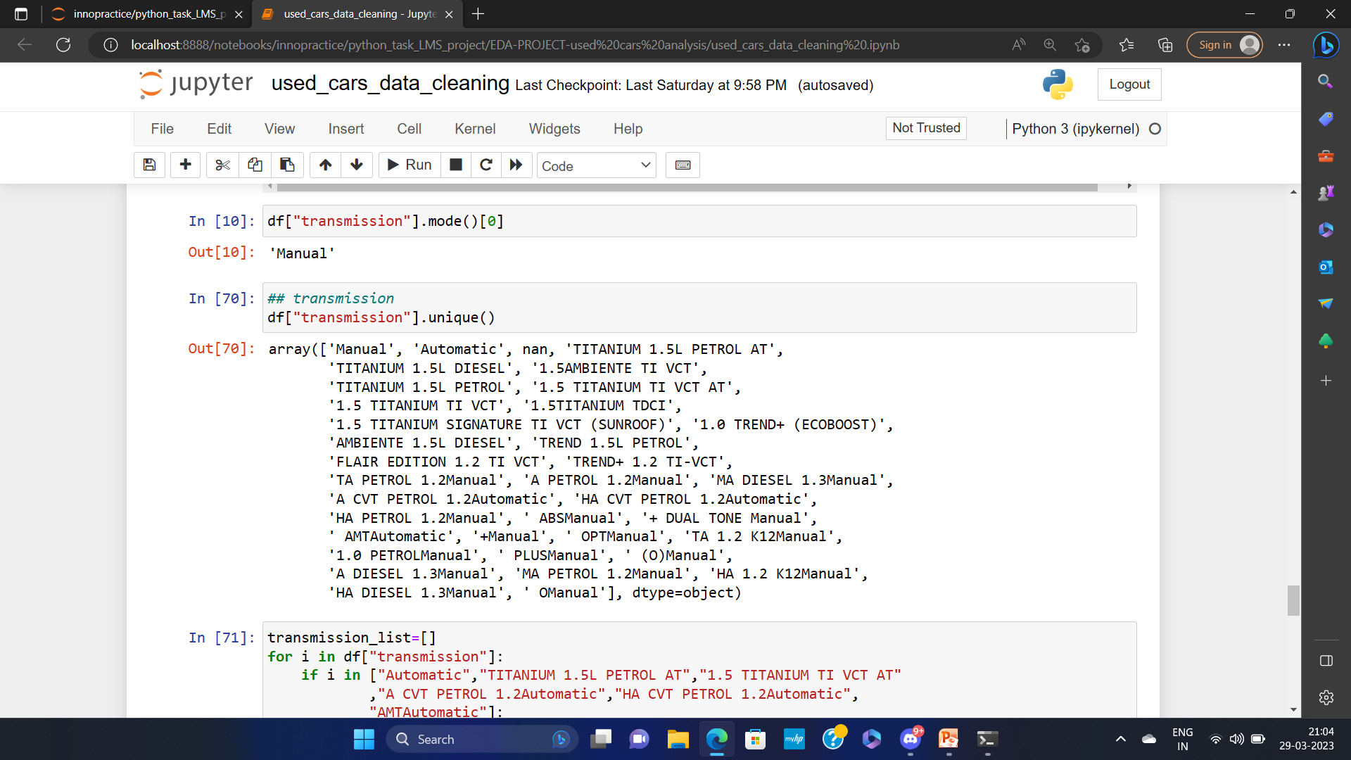
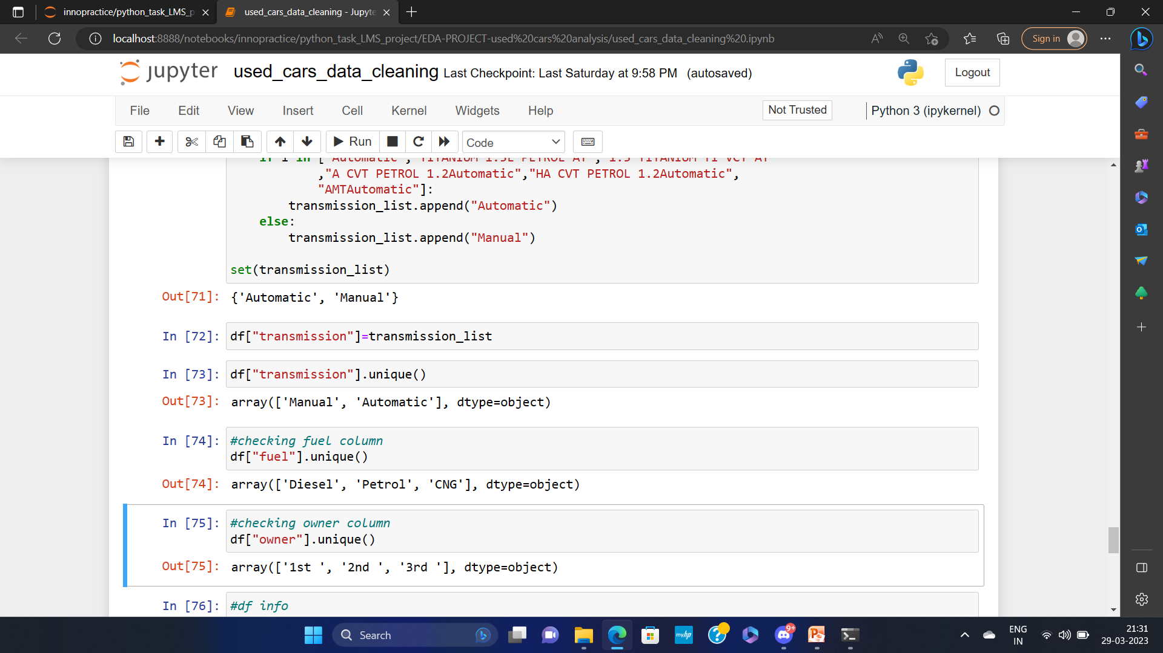

Slide 11
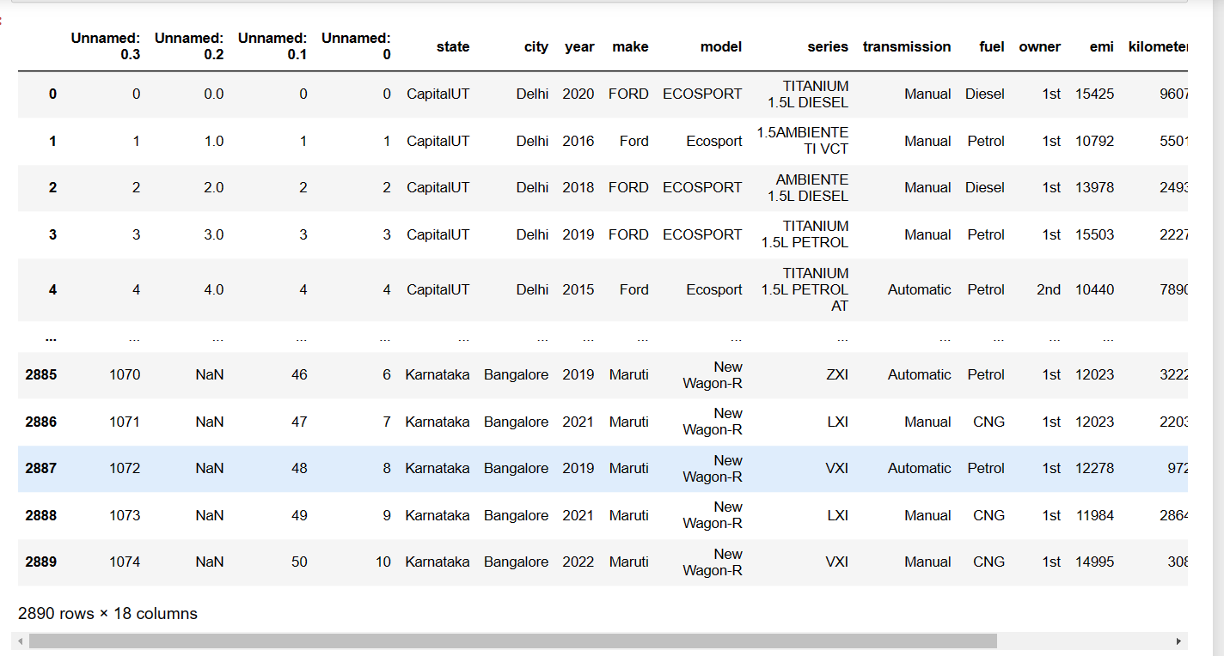
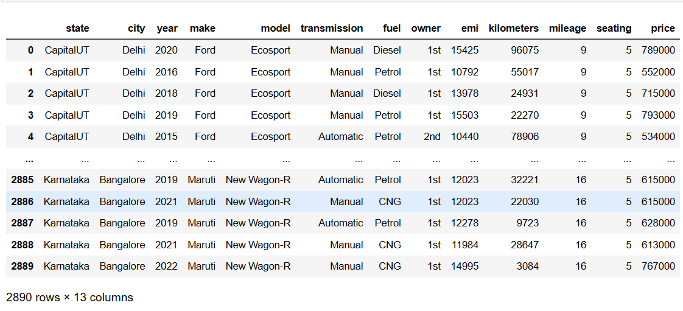
DATA BEFORE CLEANING | DATA AFTER CLEANING

Slide 12
DATA ANALYSIS
TYPES OF ANALYSIS
MULTIVARIATE
BIVARIATE
MULTIVARIATE
BIVARIATE
UNIVARIATE
BIVARIATE
UNIVARIATE
UNIVARIATE
CATEGORICAL
NUMERICAL
CAT
Vs CAT
CAT Vs NUM
NUM VS NUM

Slide 13
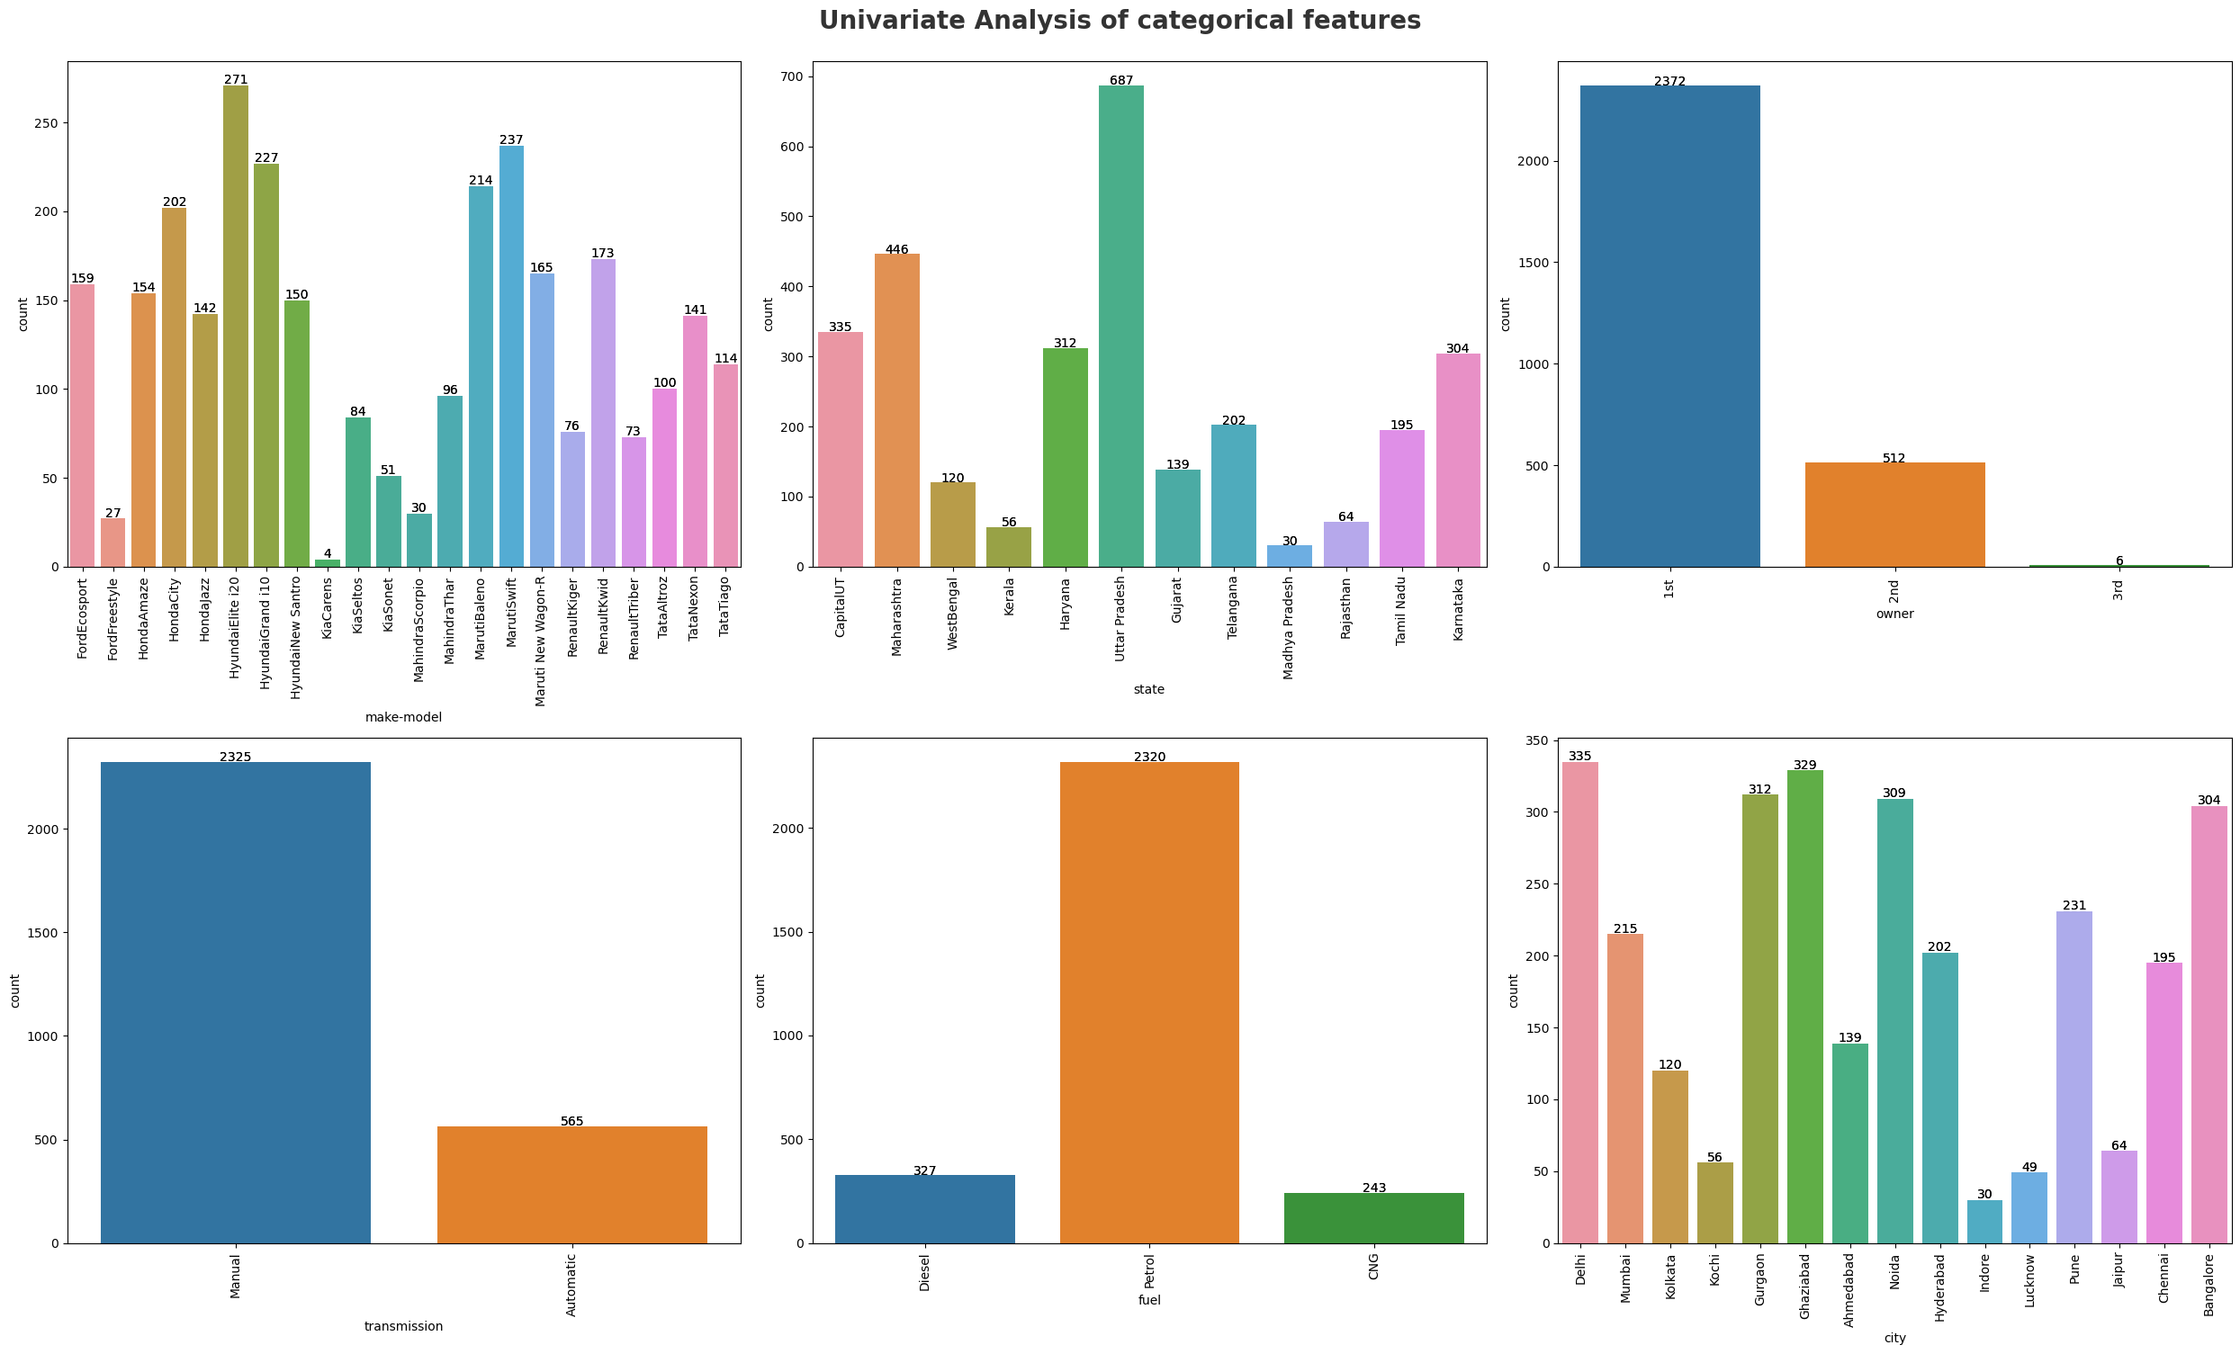
UNIVARIATE ANALYSIS
Analysing the distribution of the data on only one variable at a time

Slide 14
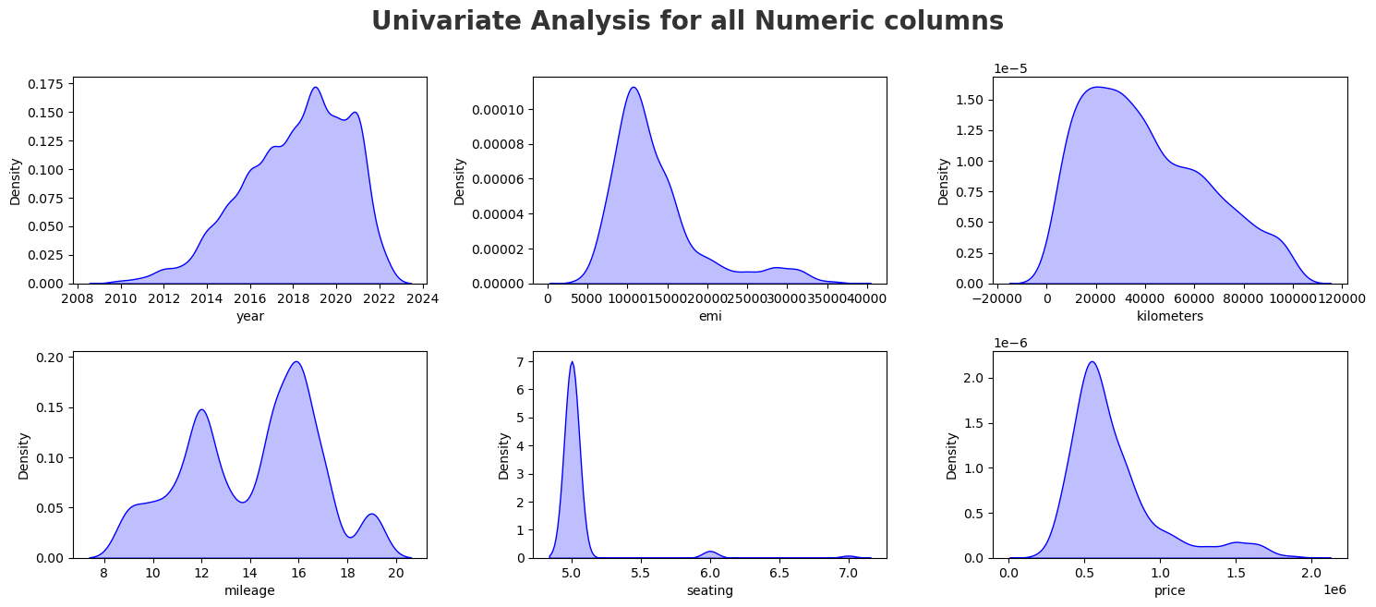
UNIVARIATE ANALYSIS
Analysing the distribution of the data on only one variable at a time

Slide 15
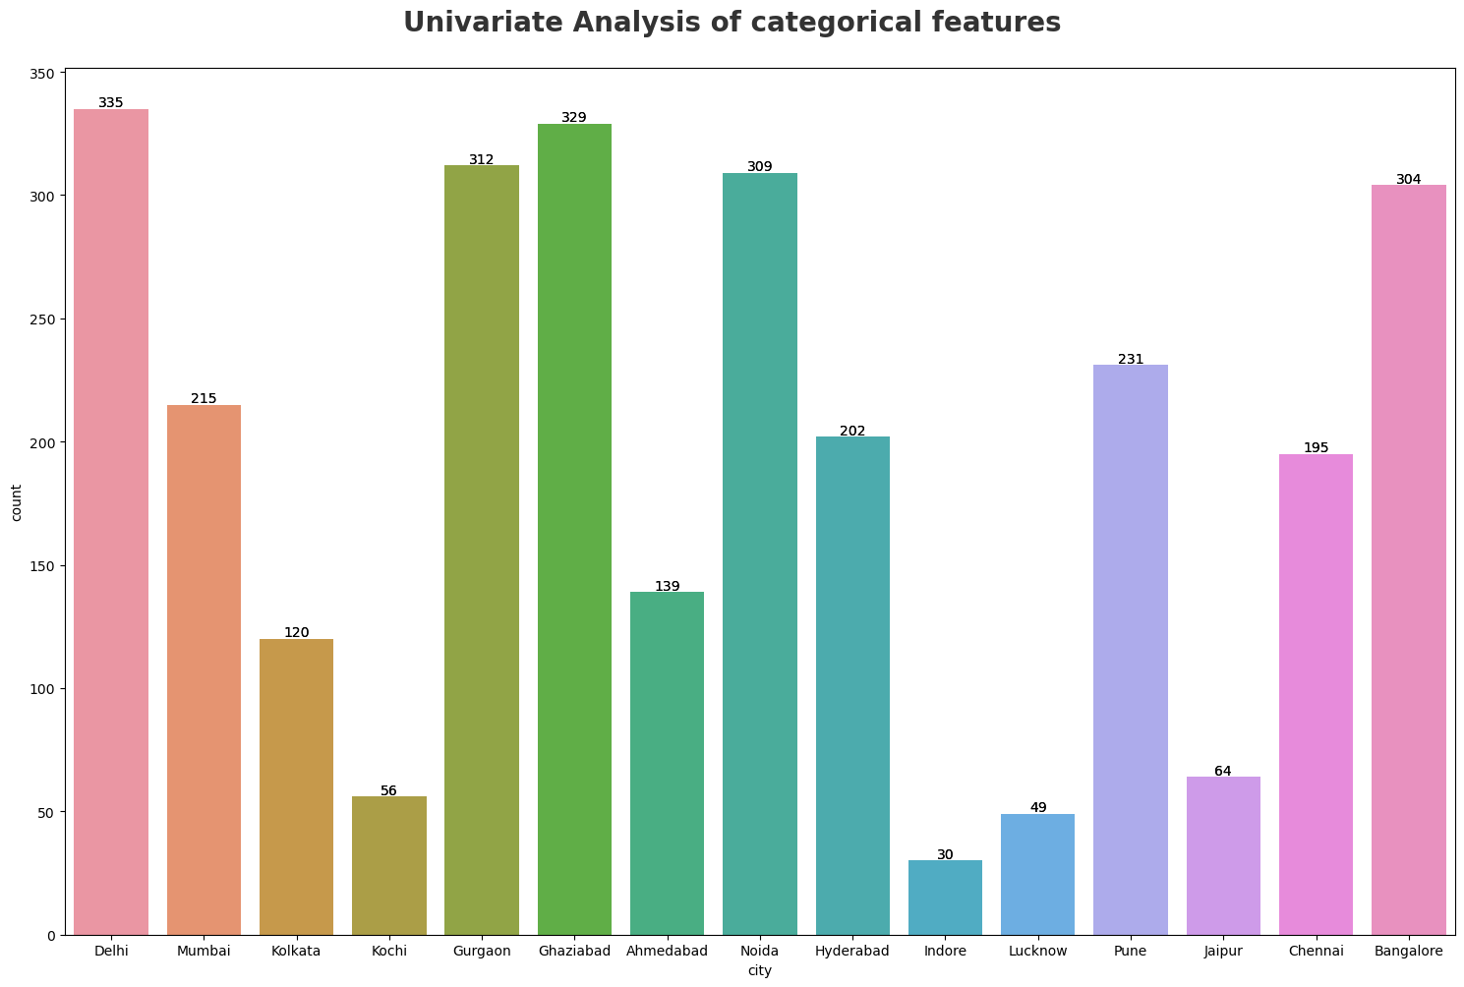
Which city people majority put their cars on sale?
Maximum number of used cars are in Delhi. Minimum number of used cars are in Indore. We can observe from the graph that maximum Used cars are from major cities like Delhi, Bangalore, Ghaziabad, Gurgaon , Noida.

Slide 16
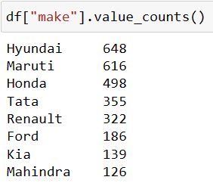
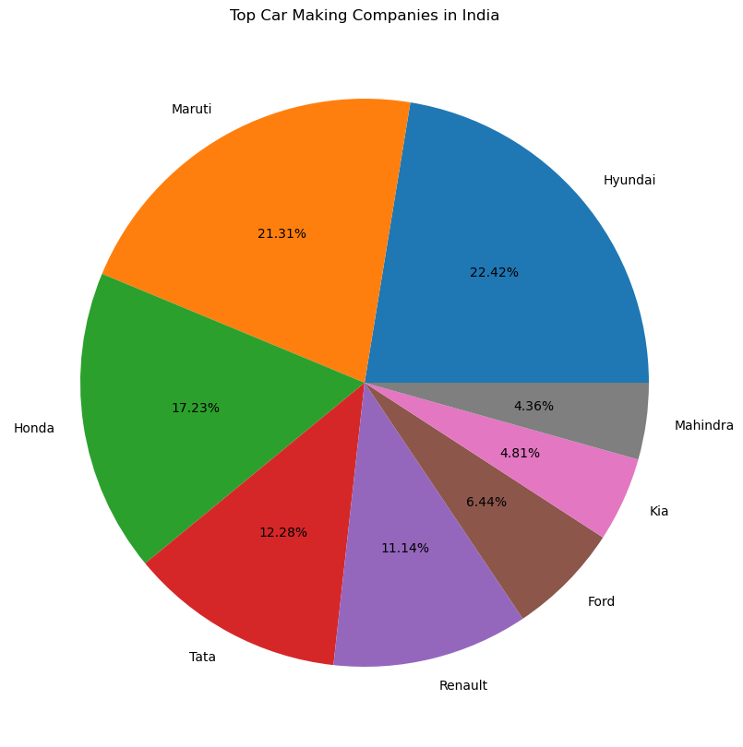
What is the percentage of used cars based on the companies?
W
Maximum number of cars are of Hyundai company.
Minimum number of cars are of Mahindra company .
By viewing the chart we can easily guess that Hyundai, Maruti and Honda are having more percentage of cars.

Slide 17
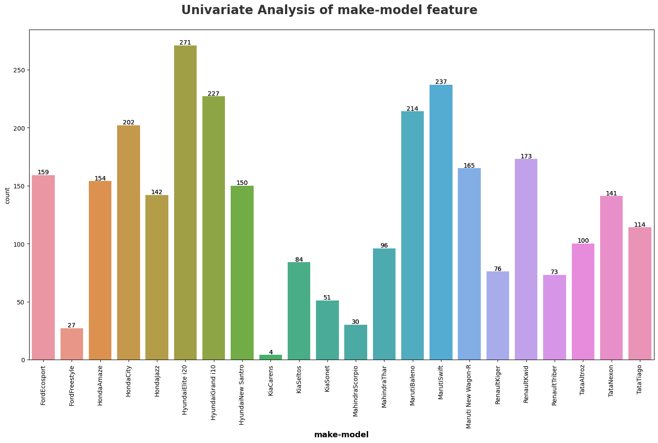
Which car brands are majority on sale?
Maximum number of cars are of Hyundai Elite i20 and Minimum are of Kia Carens are in sale.

Slide 18
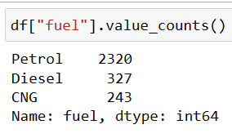
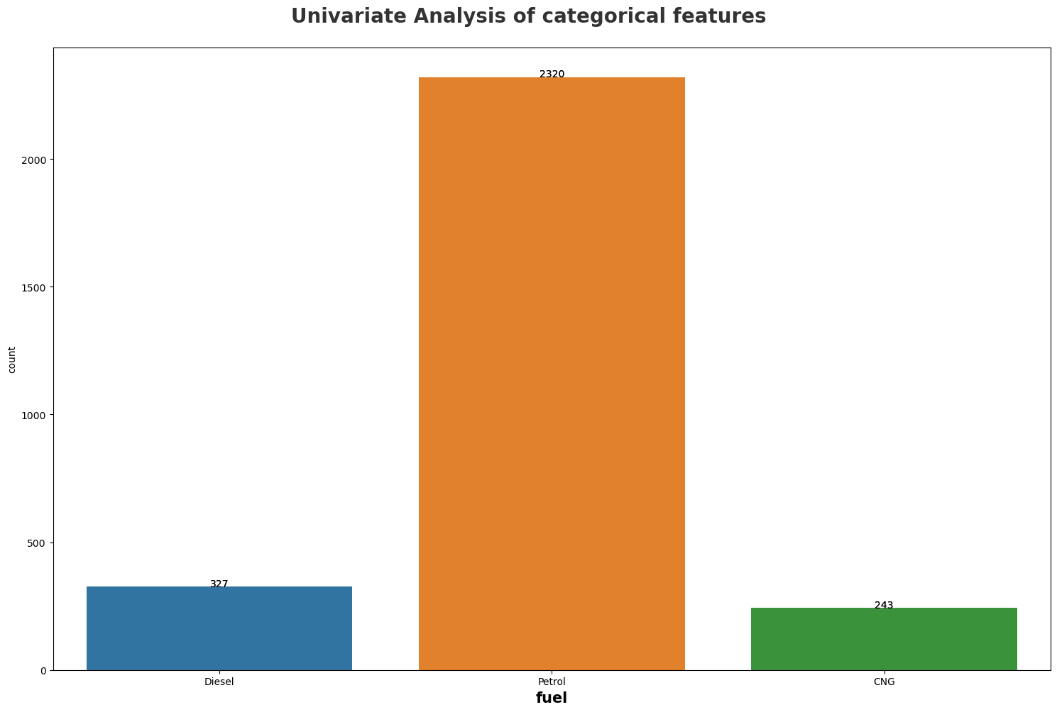
Which Fuel type cars are majority on sale??
Most of the Used cars are of Type Petrol.
Less number of cars are of type Diesel or CNG type.

Slide 19
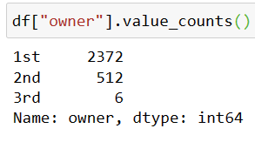
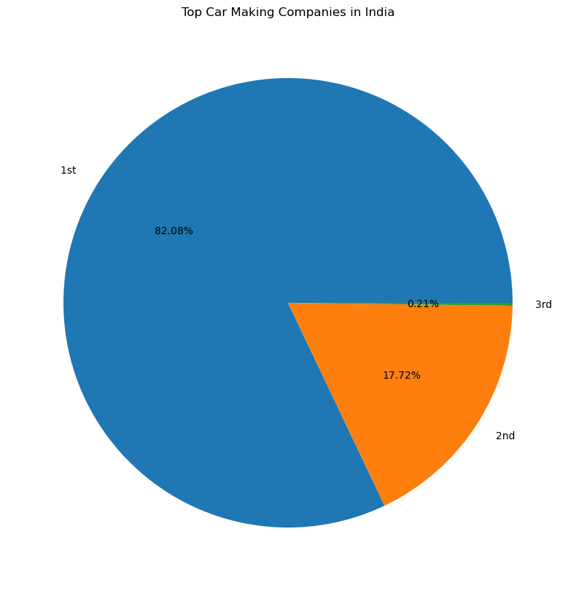
Which owner’s cars are of majority on sale?
Maximum Number of Used cars are of from 1st Owner.
By observing the graph itself we can say that most cars are of 1st owner and less are of 2nd owner.
We can’t even view the cars are of 3rd owner.

Slide 20
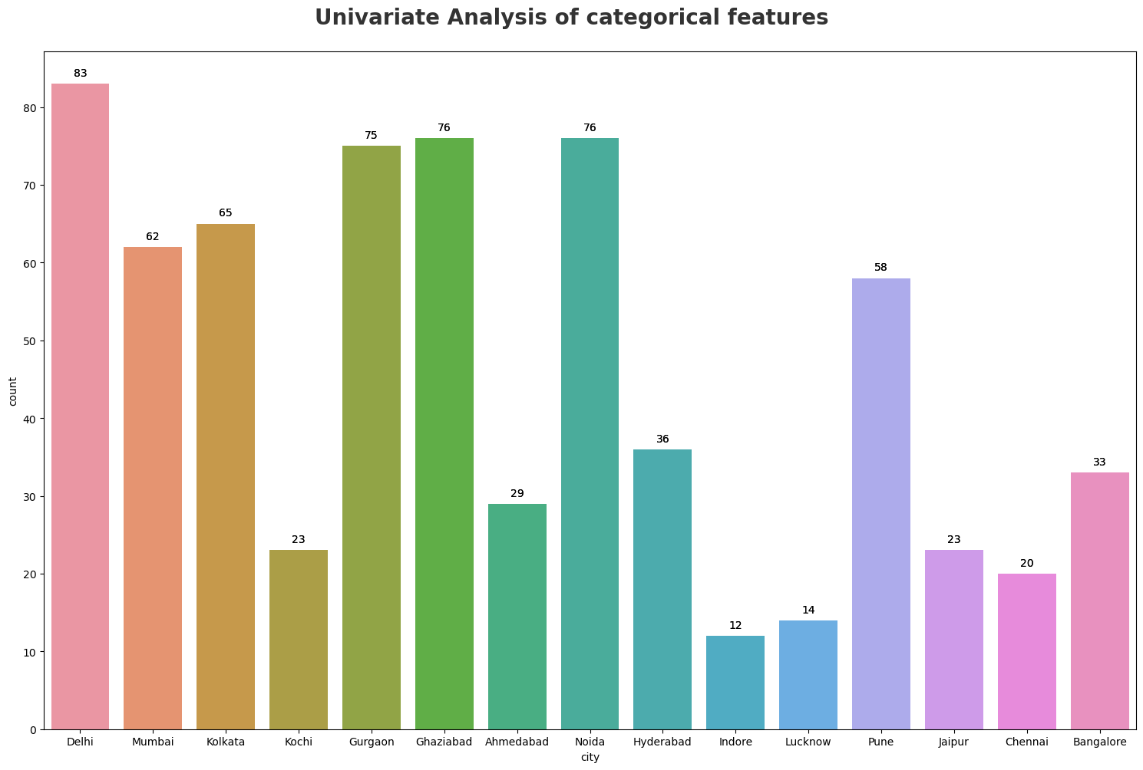
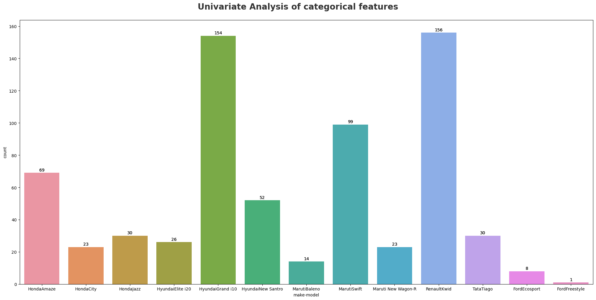
How many cars are below 5lakhs budget in different cities and models?
The maximum number of cars are in Delhi in the given budget.
The maximum number of cars are of Renault Kwid model.

Slide 21
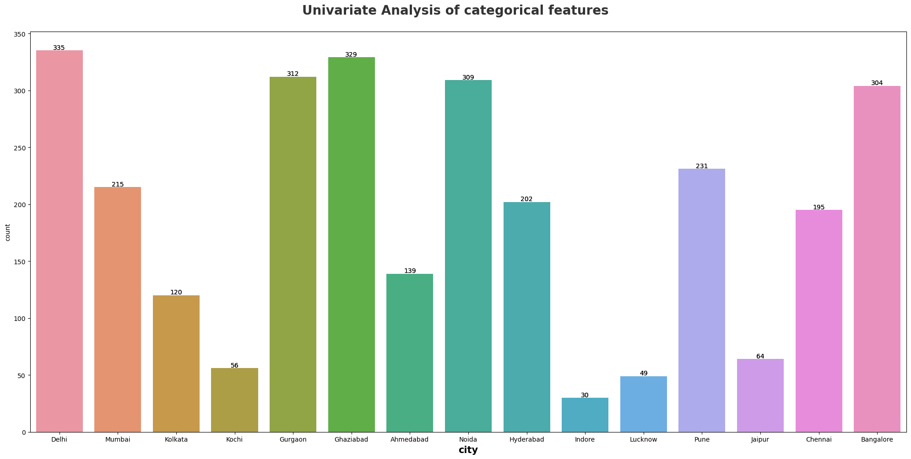
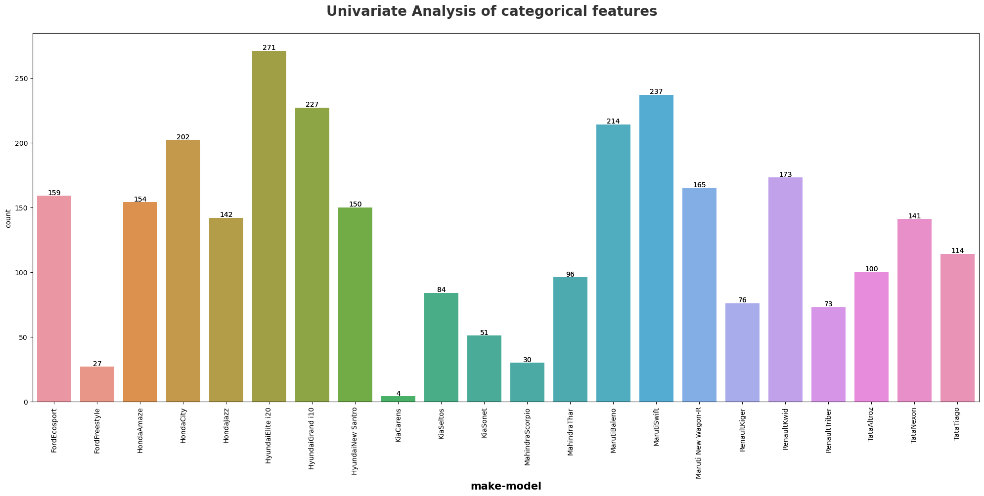
How many cars are above 5lakhs and below 10lakhs budget in different cities and models?
Maximum number of cars with in the given budget are in Delhi.
Maximum number of cars with in our budget are of Hyundai Elite i20.

Slide 22
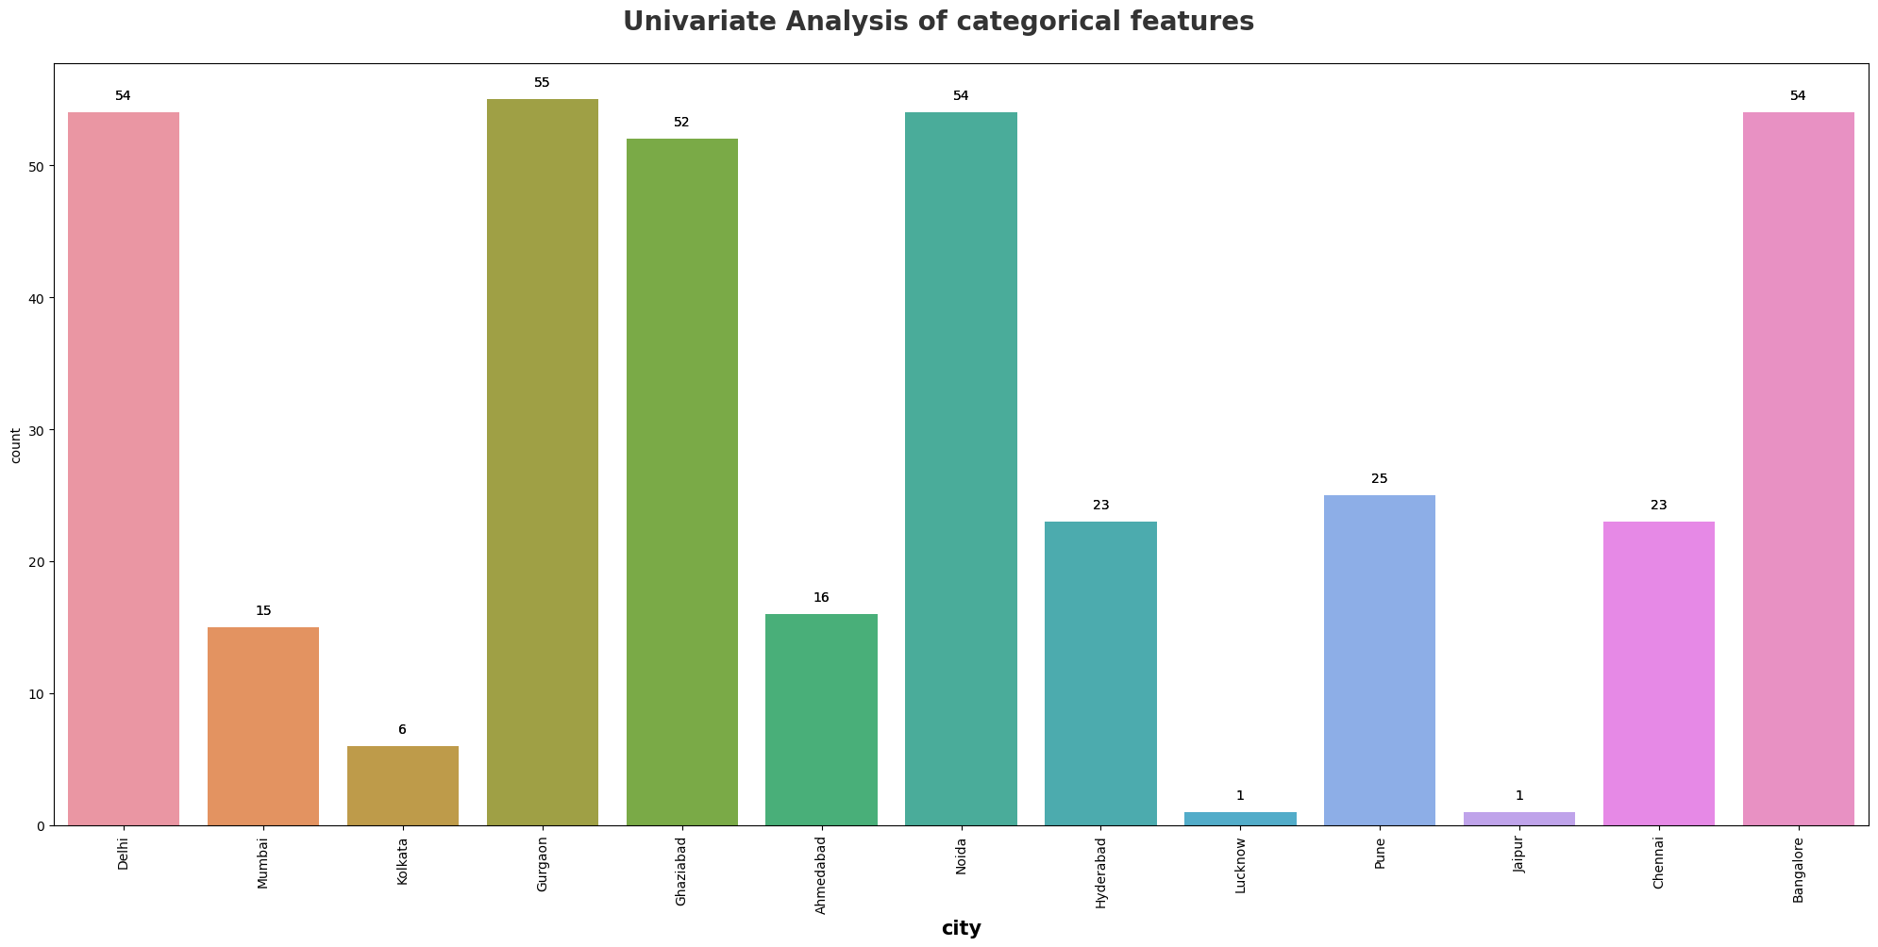
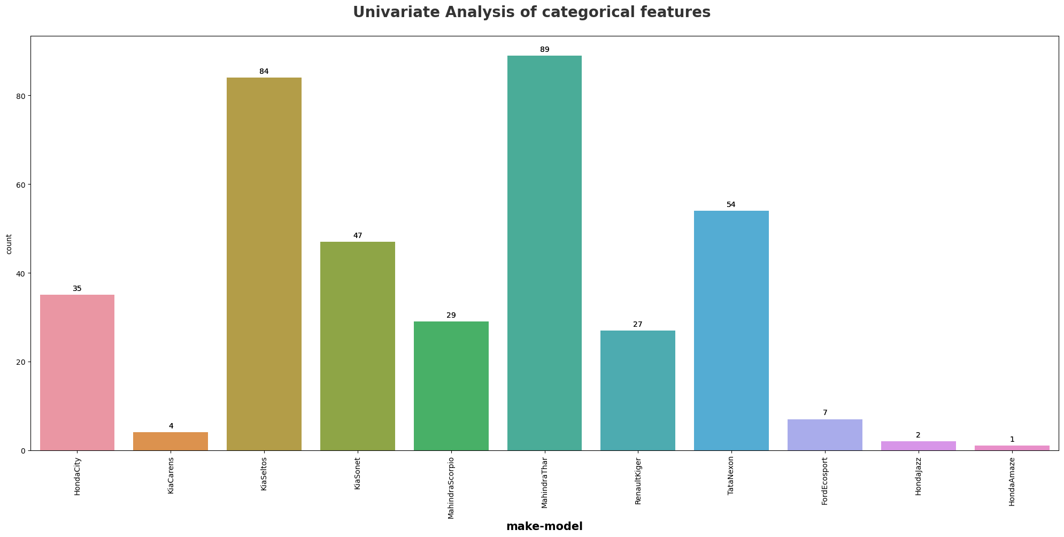
How many cars are above 10lakhs budget in different cities and models?
Maximum number of cars with the budget are in Gurgaon. Same number of cars in Delhi, Bangalore and Noida.
Mahindra Thar have the more cars in the given budget.

Slide 23
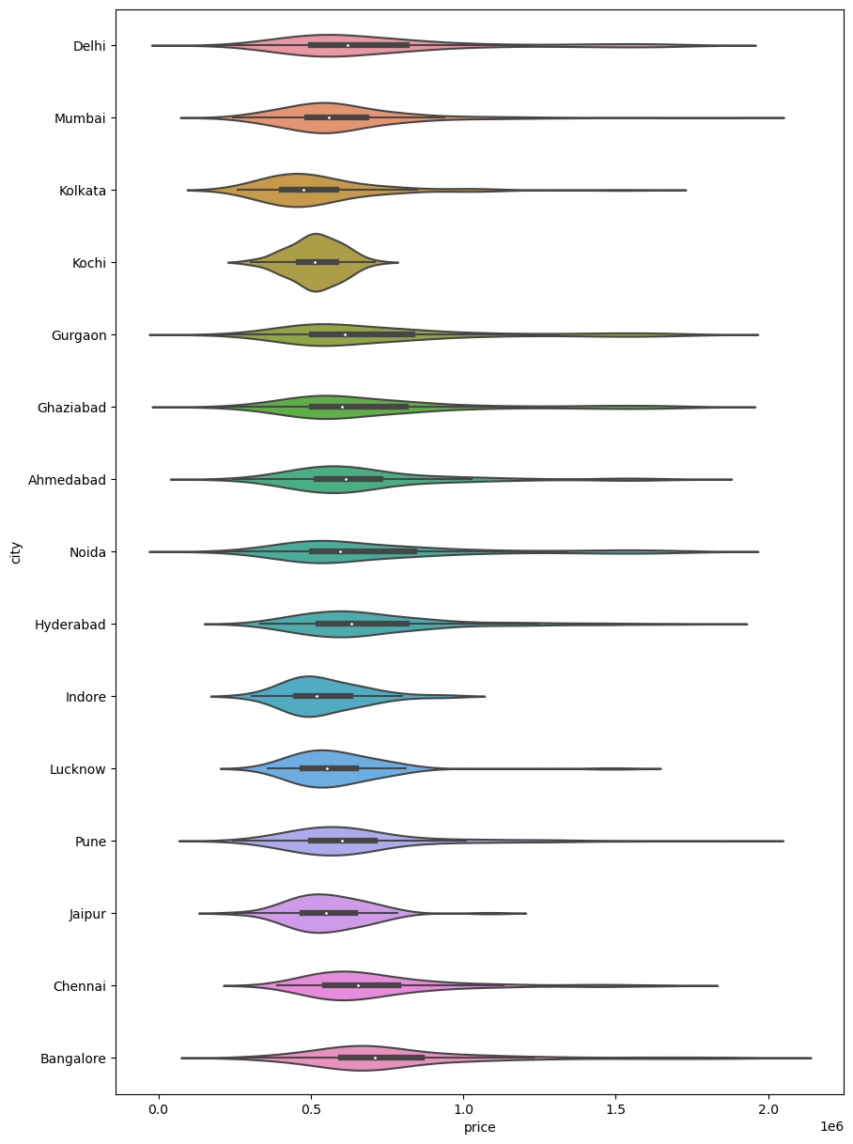
BIVARIATE ANALYSIS
Analysing the distribution of the data on two variables under Categorical Vs Numerical
How does the price of used cars varies in different cities? Categorical Vs Numerical Category City Vs Price

Slide 24
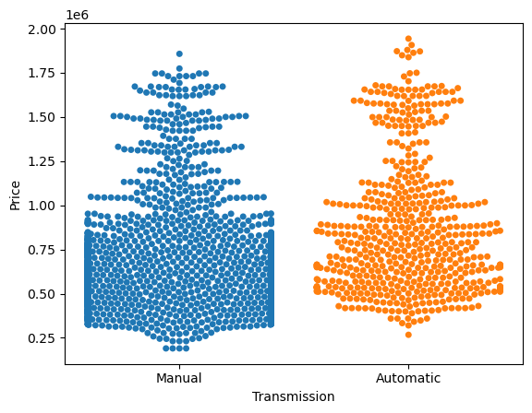
BIVARIATE ANALYSIS
Analysing the distribution of the data on two variables under Categorical Vs Numerical
How does the price of used cars varies with transmissions? Categorical Vs Numerical Category Transmission Vs Price

Slide 25
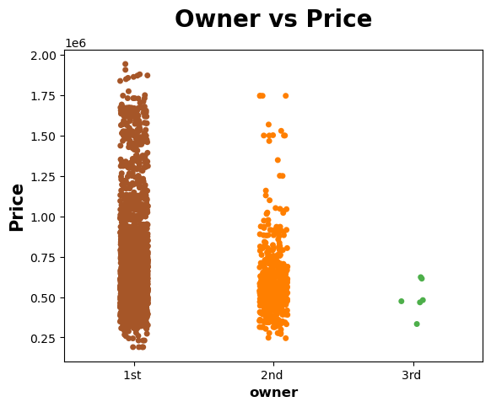
BIVARIATE ANALYSIS
Analysing the distribution of the data on two variables under Categorical Vs Numerical
How does the price of used cars varies with Owner type ? Categorical Vs Numerical Category Owner Vs Price

Slide 26
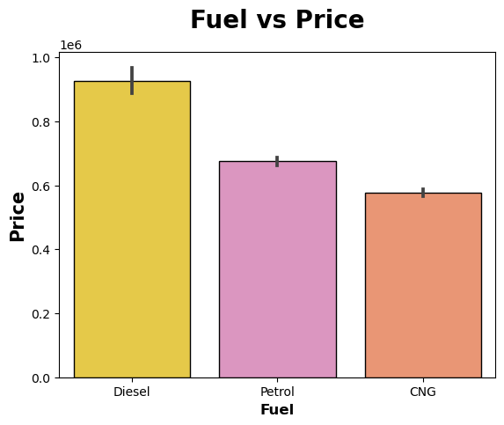
BIVARIATE ANALYSIS
Analysing the distribution of the data on two variables under Categorical Vs Numerical
How does the price of used cars varies with fuel type? Categorical Vs Numerical Category Fuel Vs Price

Slide 27
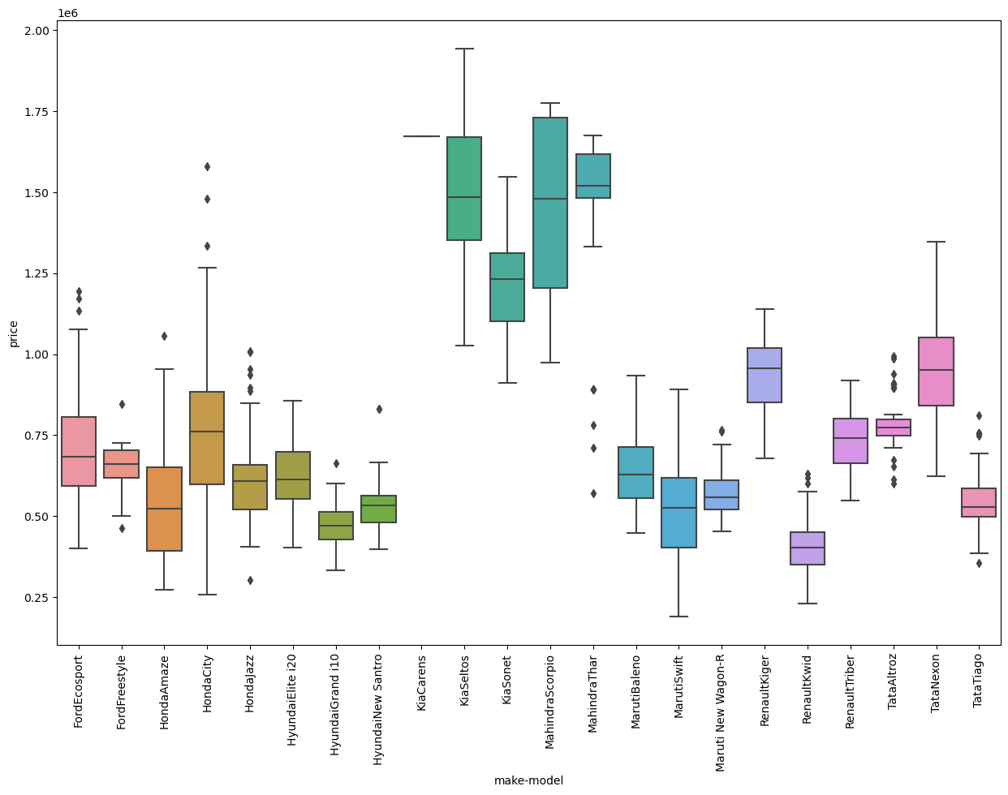
Which brand of cars have more price?
The Brand KIA and Mahindra Have more Price
Comparative to other brand cars.

Slide 28
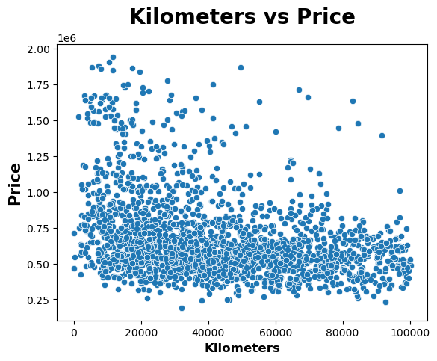
BIVARIATE ANALYSIS
Analysing the distribution of the data on two variables under Numerical Vs Numerical
How does the Prices varying based on Kilometres driven? Numerical Vs Numerical Category Kilometres Vs Price

Slide 29
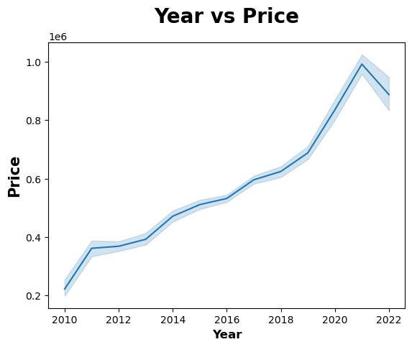
BIVARIATE ANALYSIS
Analysing the distribution of the data on two variables under Numerical Vs Numerical
How does the Prices are varying with Year of the Model? Numerical Vs Numerical Category Year Vs Price

Slide 30
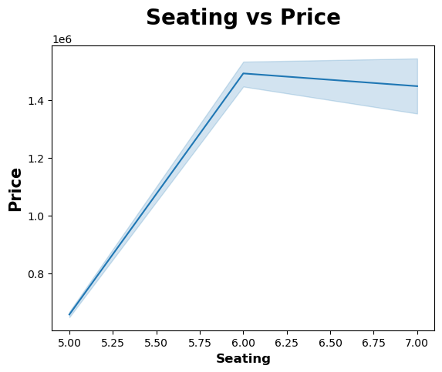
BIVARIATE ANALYSIS
Analysing the distribution of the data on two variables under Numerical Vs Numerical
How does the Prices are varying with seating? Numerical Vs Numerical Category Seating Vs Price

Slide 31
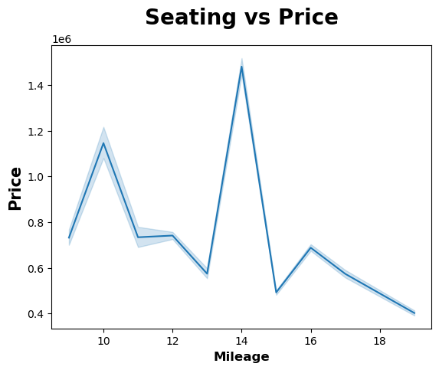
BIVARIATE ANALYSIS
Analysing the distribution of the data on two variables under Numerical Vs Numerical
How does the Prices are varying with Mileage? Numerical Vs Numerical Category Mileage Vs Price

Slide 32
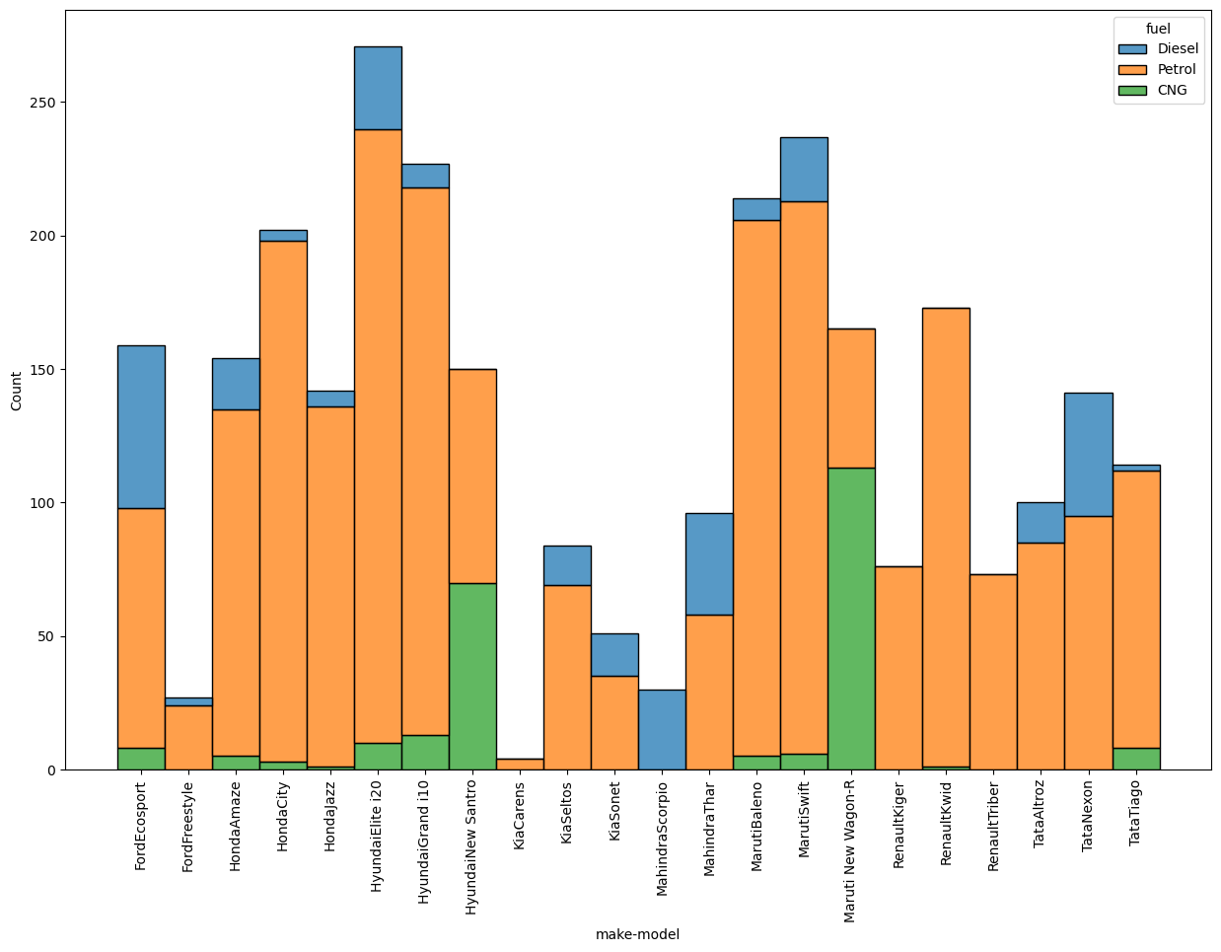
BIVARIATE ANALYSIS
Analysing the distribution of the data on two variables under Categorical Vs Categorical
Comparing used cars Brands with Fuel type: Categorical Vs Categorical make-model Vs fuel

Slide 33
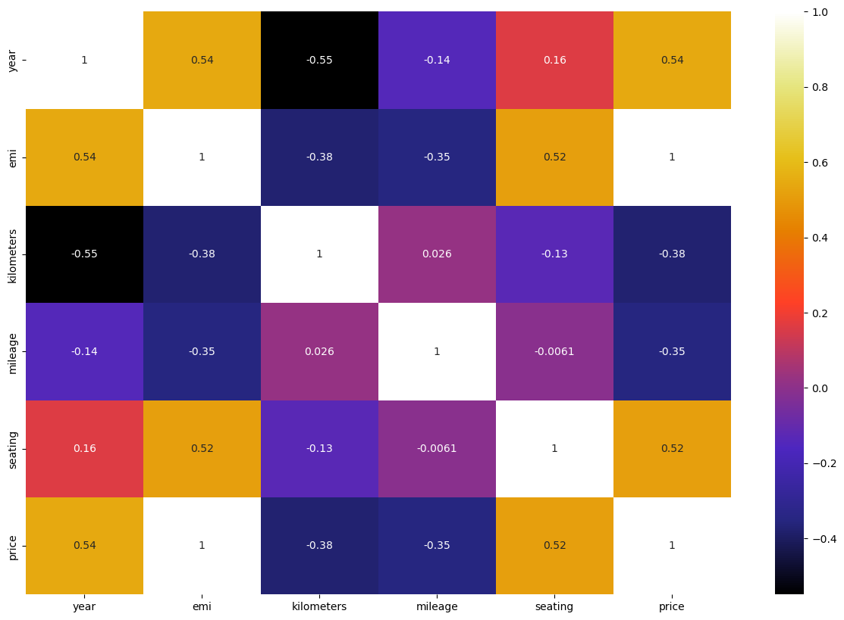
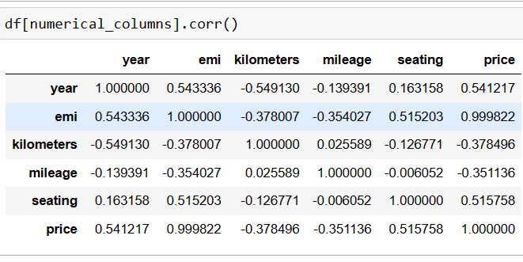
MULTIVARIATE ANALYSIS
Analysing the distribution of the data on Multiple Variables
The Correlation between numerical Features:

Slide 34
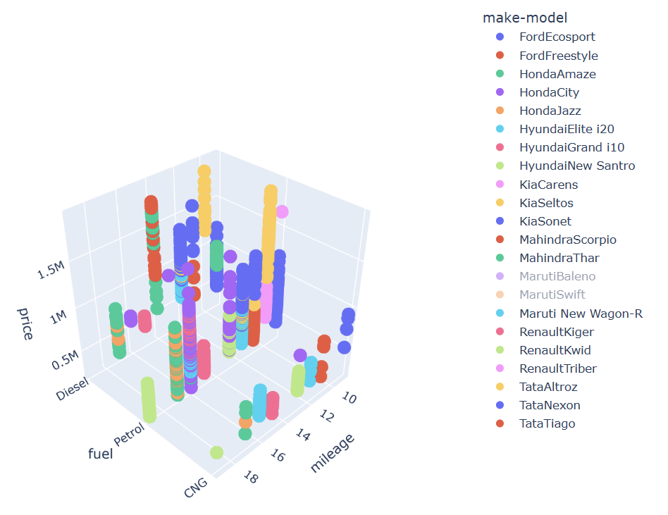
MULTIVARIATE ANALYSIS
Analysing the distribution of the data on Multiple Variables

Slide 35
CHALLENGES FACED
FIRST CHALLENGE – LARGE AMOUNT OF DATA TO BE COLLECTED
FINDING THE PROPER WEBSITE
WITH SINGLE WEBPAGE WE COULD ONLY COLLECT 20 RESULTS USING REQUESTS LIBRARY

Slide 36
CONCLUSION
The price column is the target.
There are outliers in the km and price.
Vehicle age has a negative impact on the price.
Manual cars are mostly in numbers and automatic has a higher selling average price than manual cars.
Petrol is the most preferred choice of fuel on the used car website, followed by diesel and LPG.
There were very few missing values in our dataset.
EDA is an essential step in the data science process, and is crucial for understanding, cleaning, and preparing data for further analysis. By thoroughly exploring and summarizing a dataset, we can gain valuable insights and can make informed decisions about how to proceed with their analysis.

Slide 37

THANK YOU

